Slide 1
Welcome
My Name is Anthony Shaw
The title of my talk is What’s new in Python 3.11
My presentation will be in English
The presentation materials are in English and some Japanese.
I will publish the presentation materials to aka.ms/pyconjp-slides
I agree to having my picture taken during my presentation.
I will comply with the PyCon JP Code of Conduct.

Slide 2

What’s new in Python 3.11
Python 3.11の新機能
Anthony Shaw
@anthonypjshaw

Slide 3
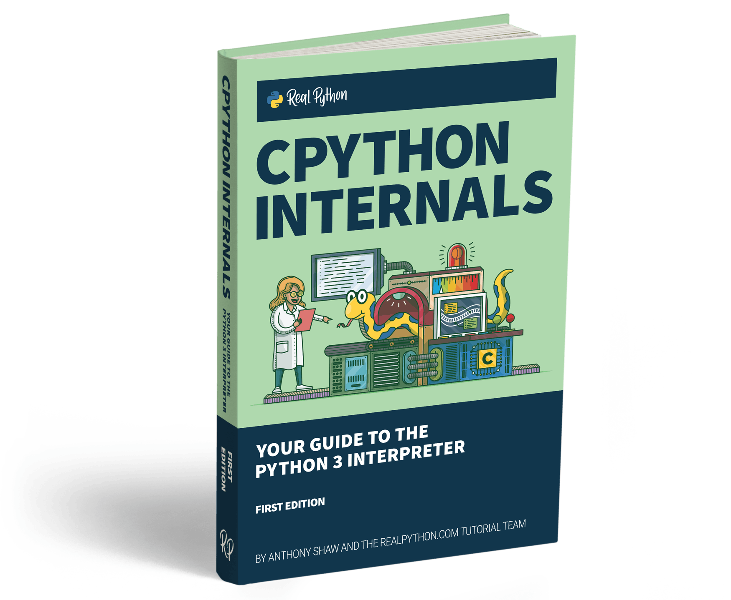


Hello!
tonybaloney.github.io
@anthonypjshaw
For more details on the guts of Python, checkout my book “CPython Internals”
aka.ms/pyconjp-slides

Slide 4
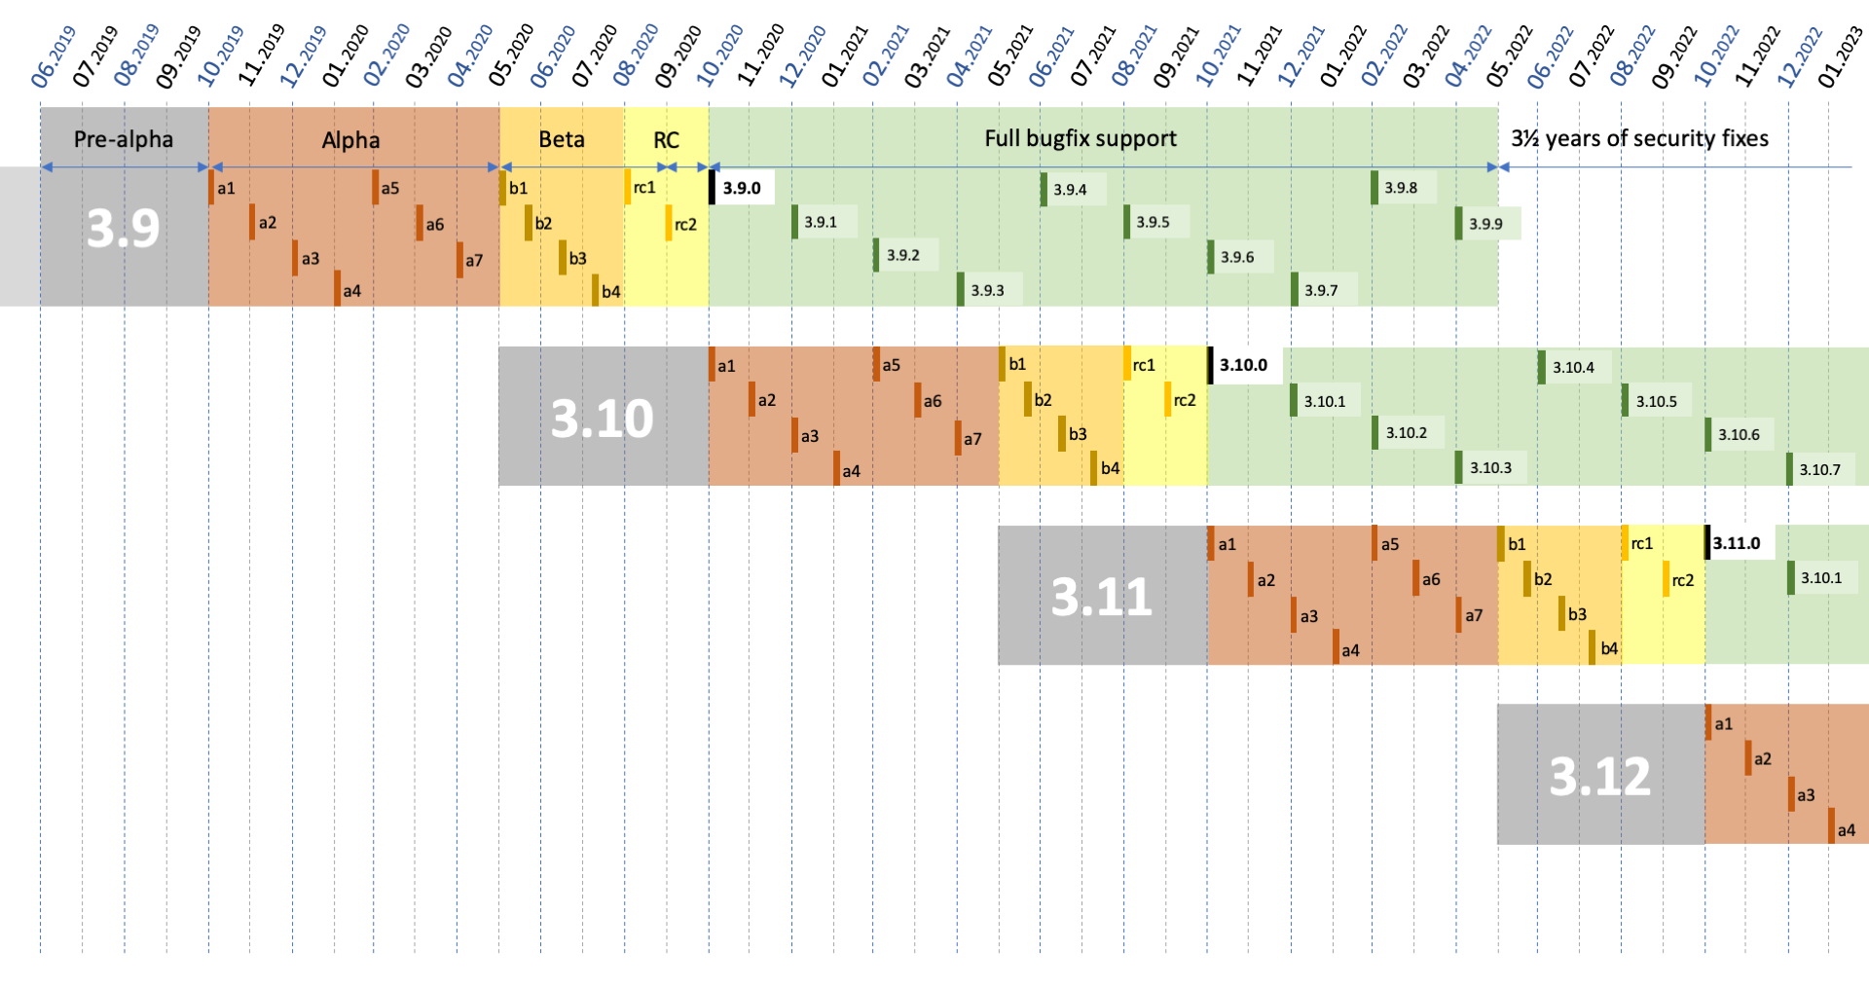
Wait, 3.11?
aka.ms/pyconjp-slides

Slide 5
3.0
3.1
3.2
3.3
3.4
3.5
3.6
3.7
3.8
3.9
3.10
3.11
3.12
Alpha releases
Beta release
First Stable release of 3.x
F-strings
ASync
Type Annotations
Typing improvements
Performance
improvements
aka.ms/pyconjp-slides

Slide 6
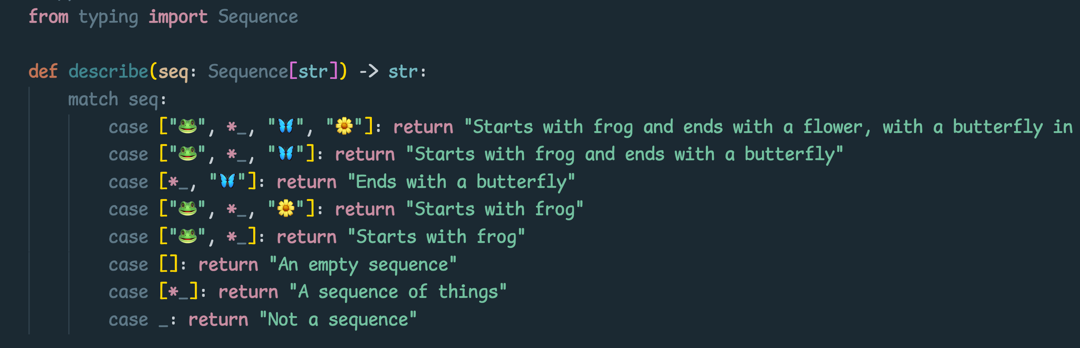
What did I miss in Python 3.10?
Python 3.10 で見逃してませんか？
Match statements!

Slide 7
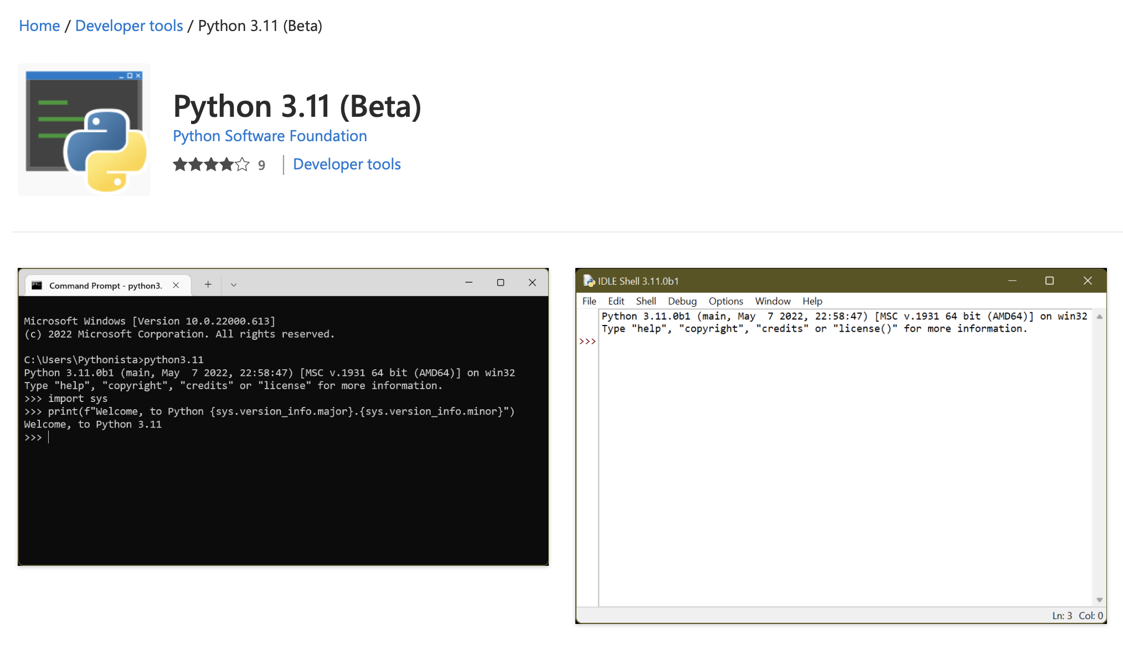
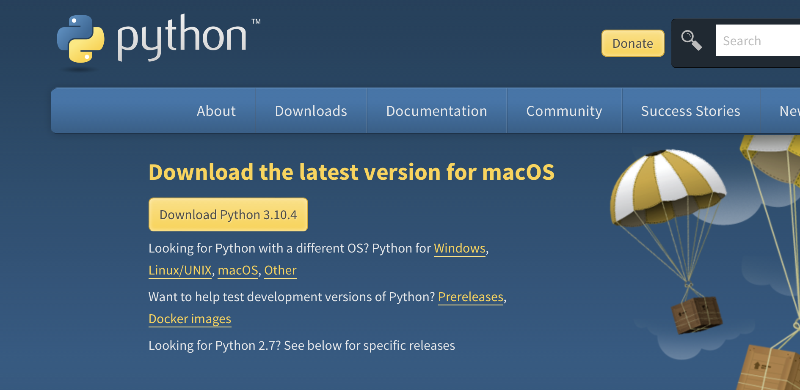
Installing Python 3.11
MacOS and Linux Users use python.org:
Windows Users use the Store:
Tip: Don’t compile from source unless you know how to configure profile and linker optimization

Slide 8
Changes to exceptions and error handling
Exceptionとエラー処理の変更

Slide 9
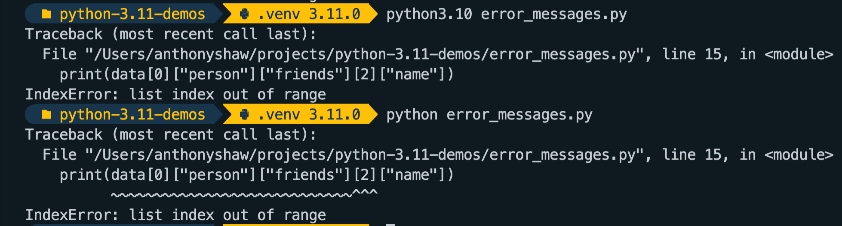
Better exception messages
Exceptionメッセージの改善
* Not yet supported in IPython

Slide 10
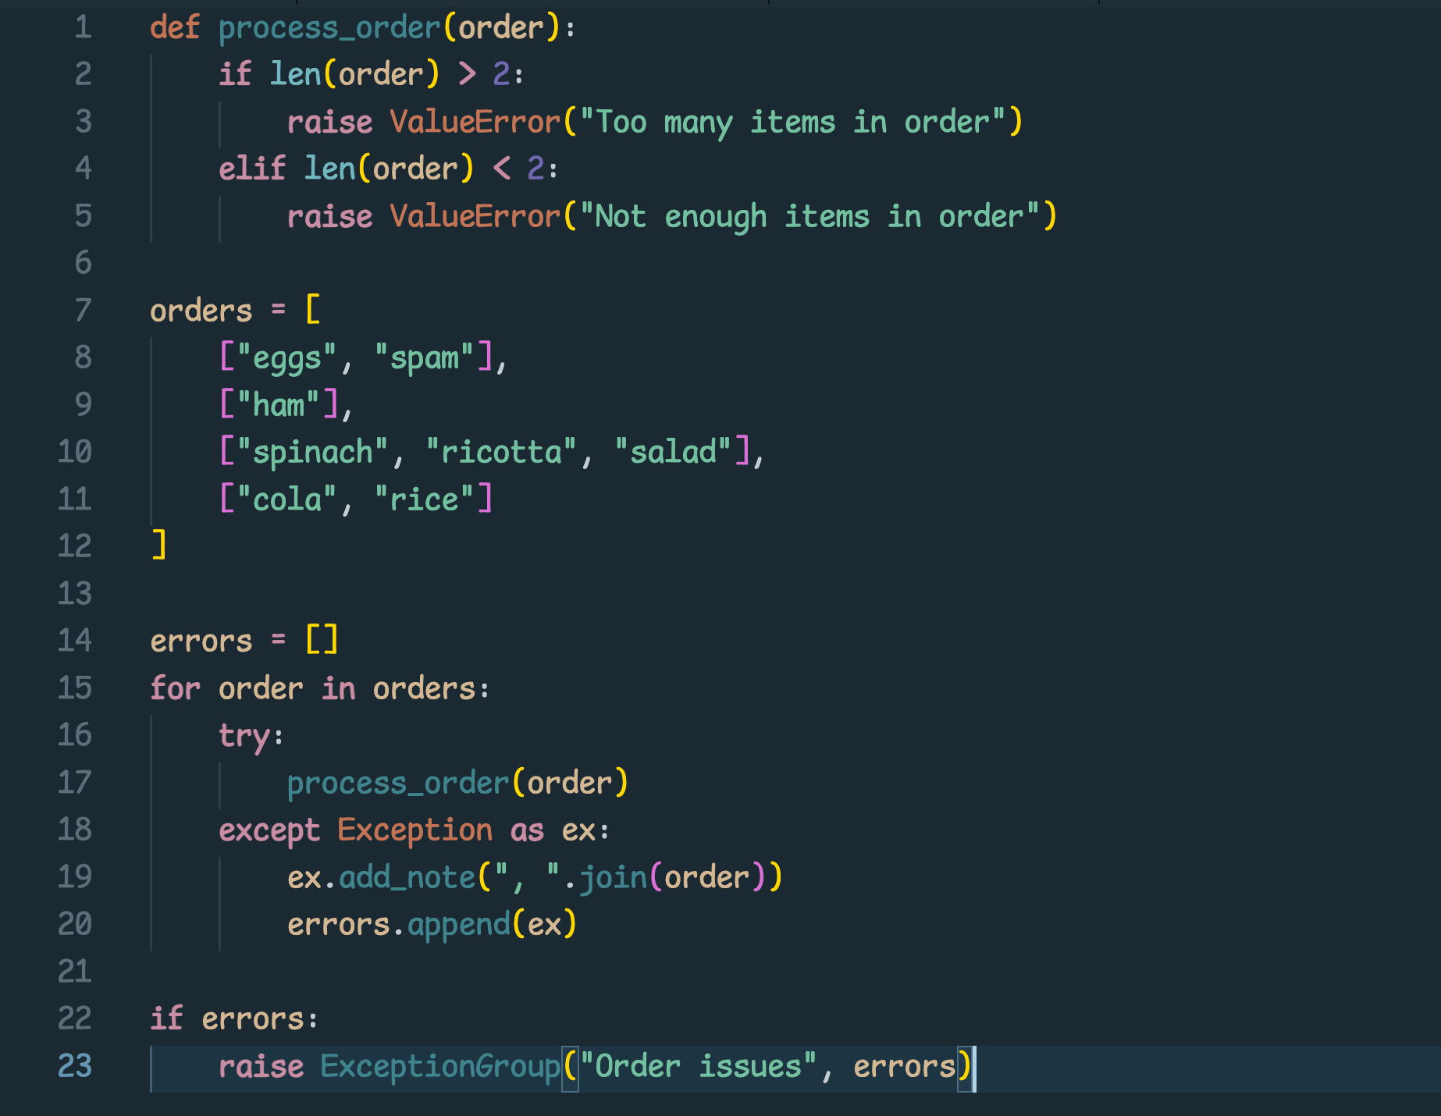
Exception Groups
add_note is a new feature in Python 3.11
Raise ExceptionGroup

Slide 11
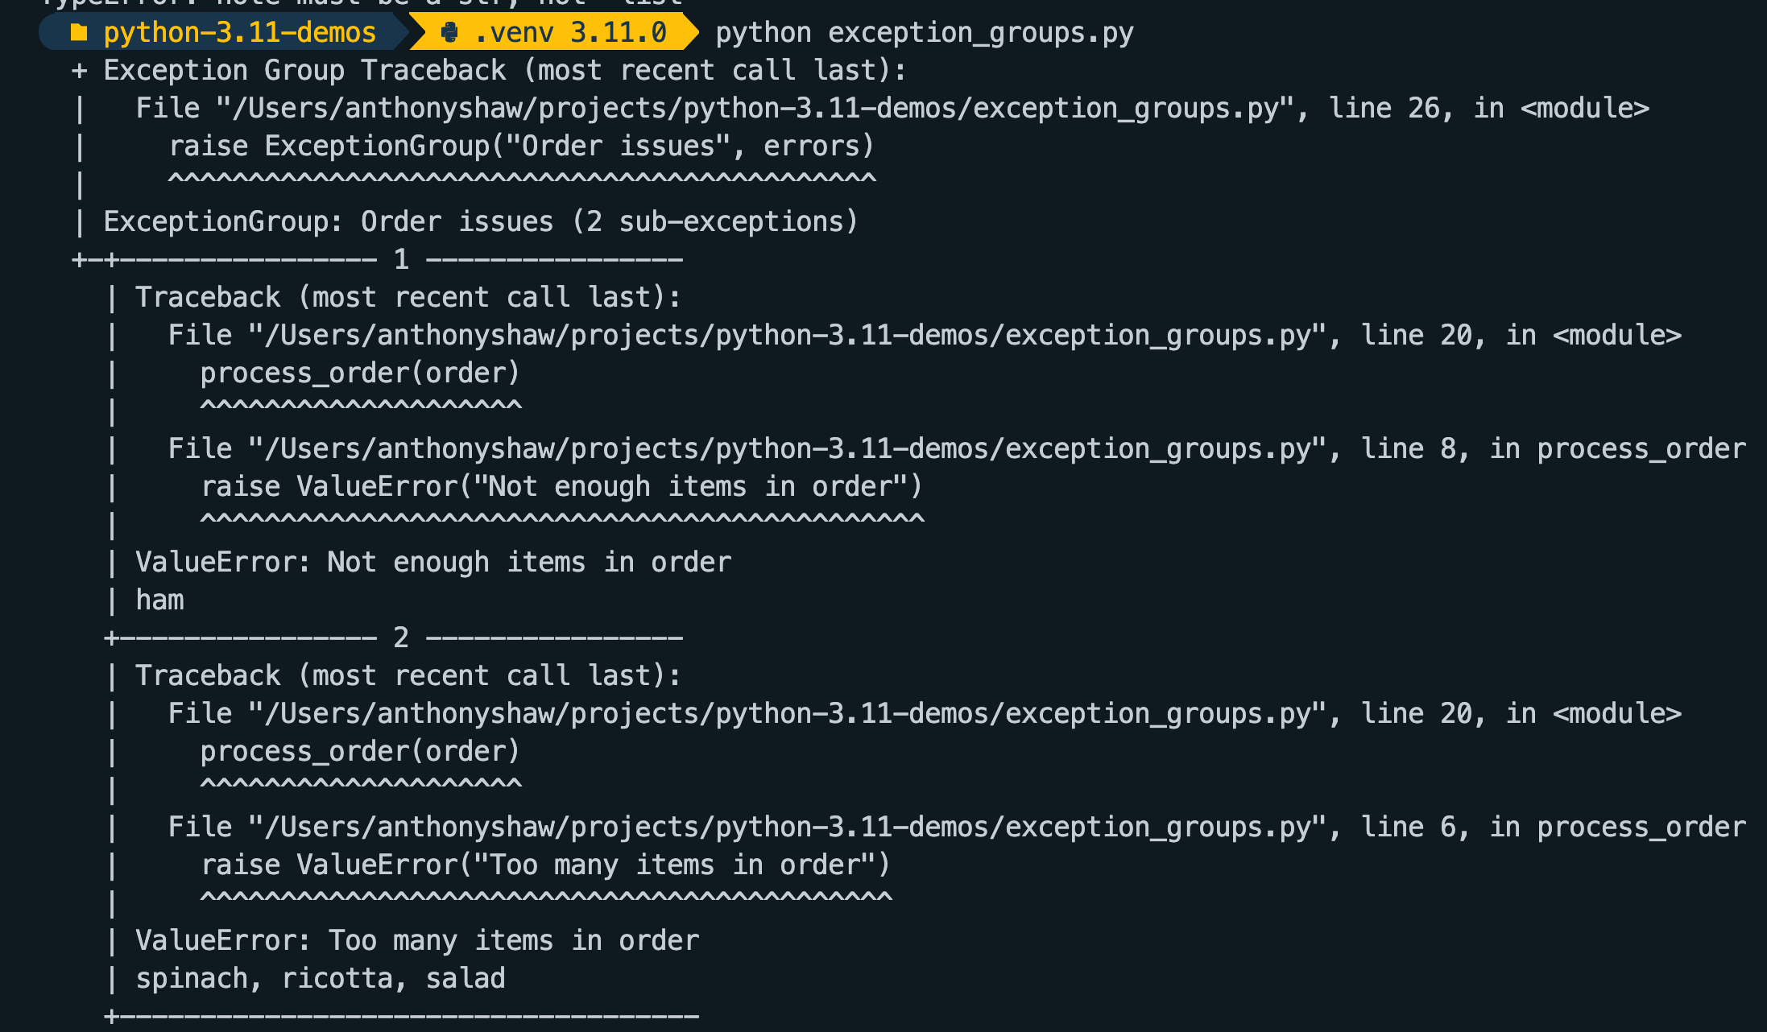
Exception Groups Tracing
Exceptionのグループ別エラーメッセージ出力

Slide 12
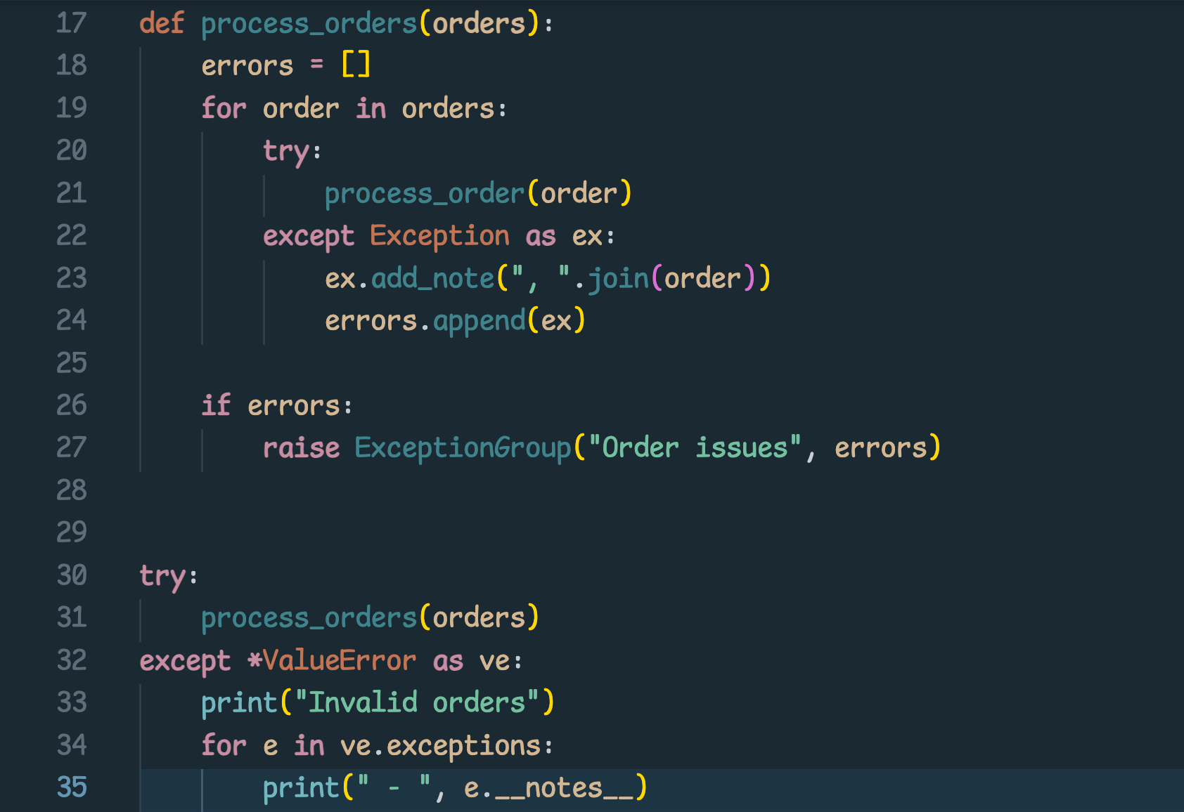
Extracting Exceptions from Groups
Exceptionのグループ化
except* ExceptionType
New exception type
New syntax
Exception is a collection of exceptions

Slide 13
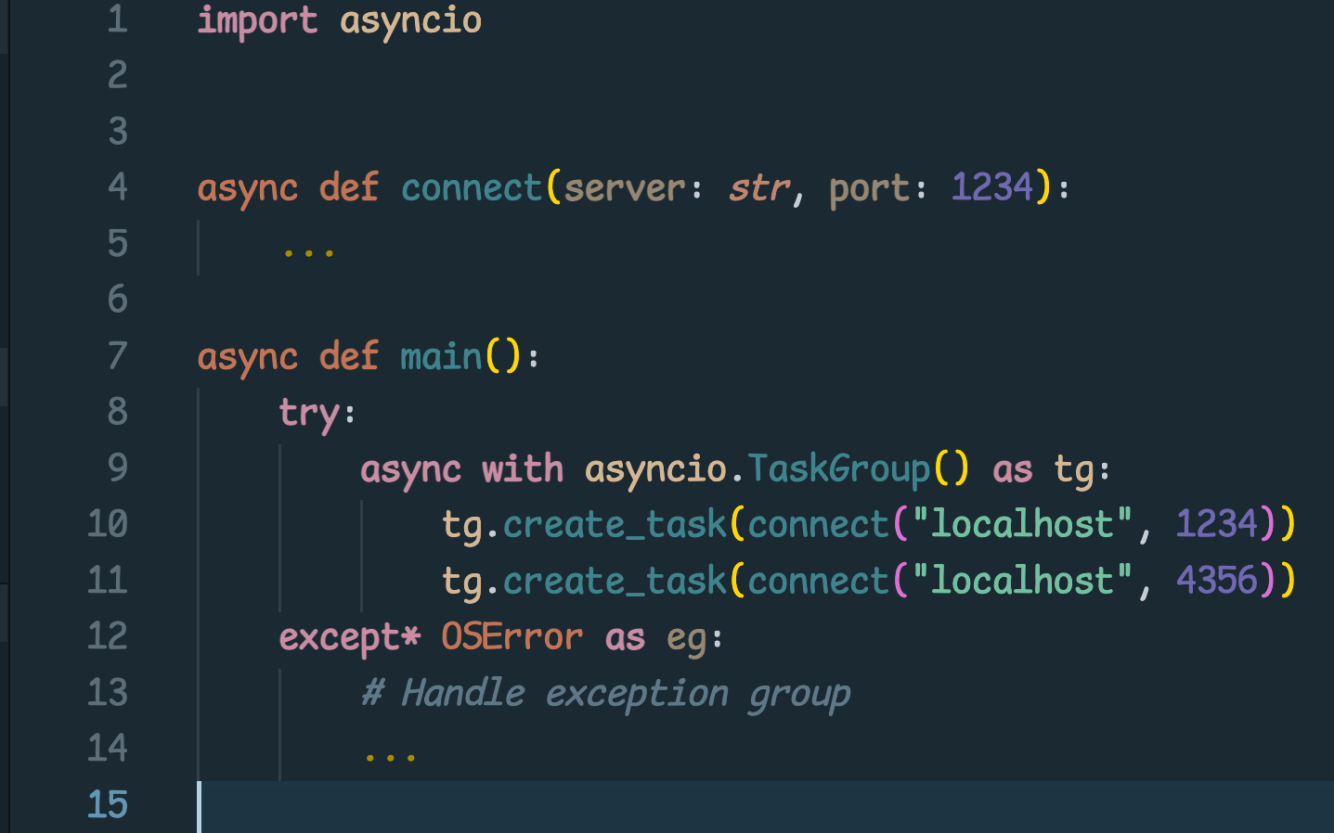
Asyncio Task Groups
Replacement for gather() API
Exceptions are raised as an Exception Group.
gather() APIの代替機能
ExceptionはExceptionグループ機能を使って発生させます

Slide 14
Typing Updates
型関連アップデート

Slide 15
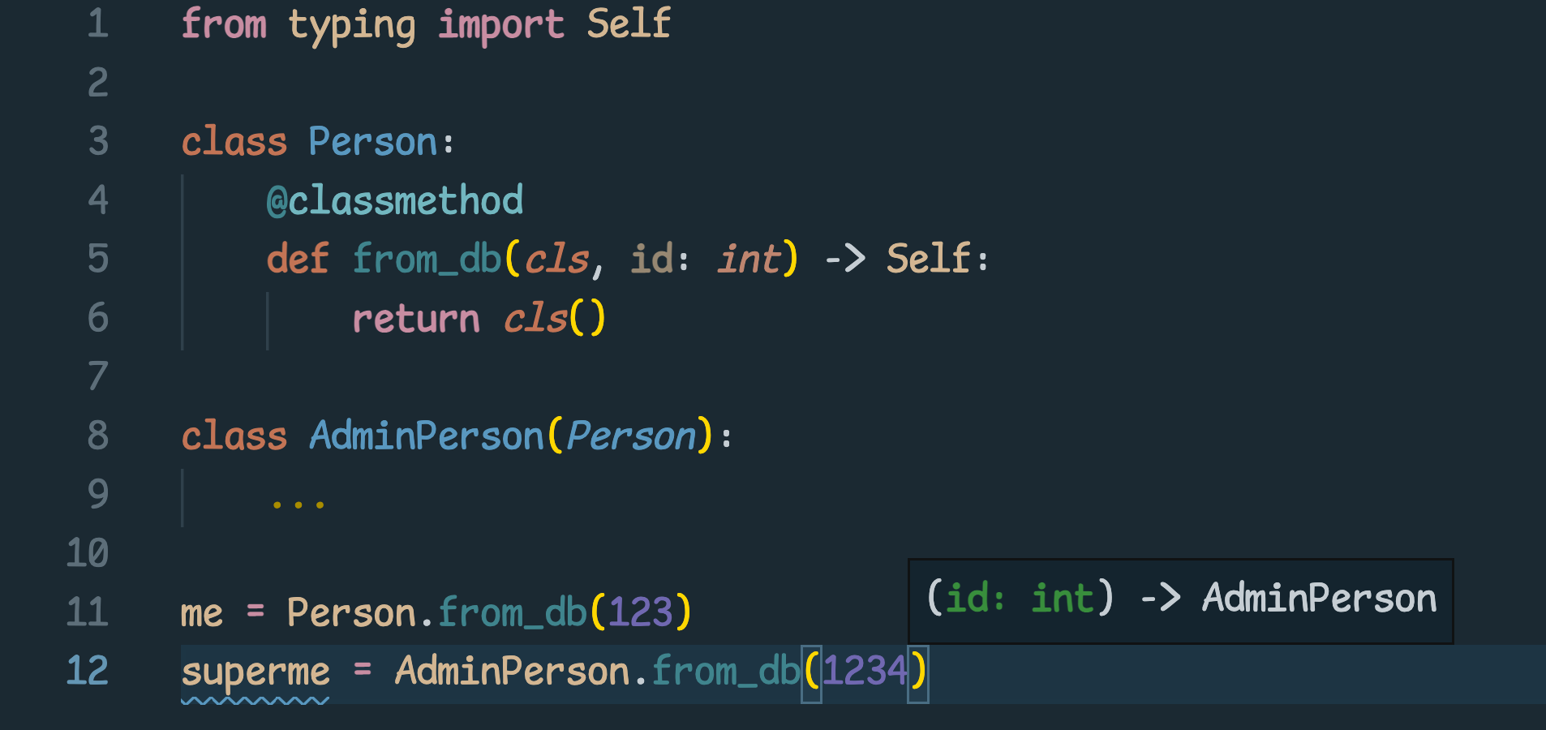
Self is now a type Translation
Ideal for class methods, like factories
Great for inheritance
ファクトリークラスや継承クラスに最適

Slide 16
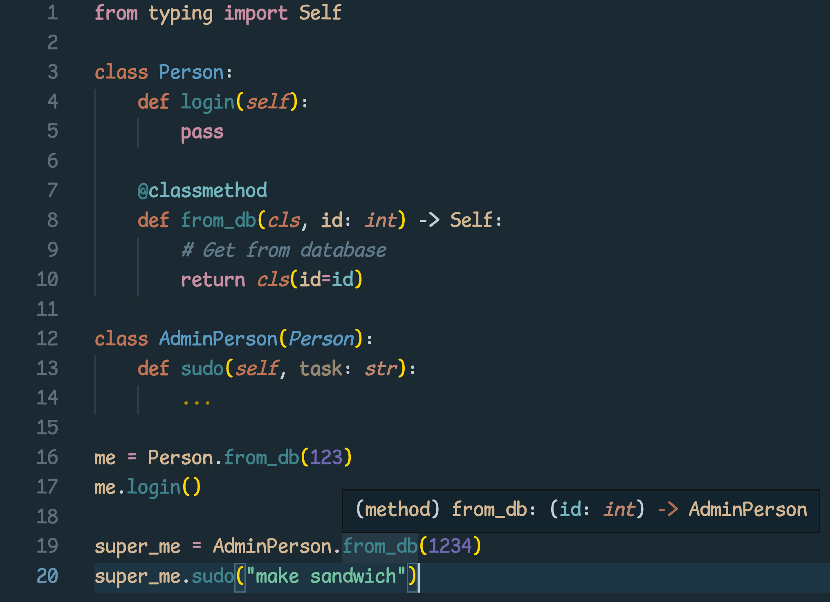
Classes than inherit from Person, calls to from_db() will return an instance of that class, not the base class.
Personを継承したクラスでfrom_db()を呼び出した場合は、継承したクラス(Person)ではなく呼び出し側のクラス(AdminPerson)を返します。

Slide 17
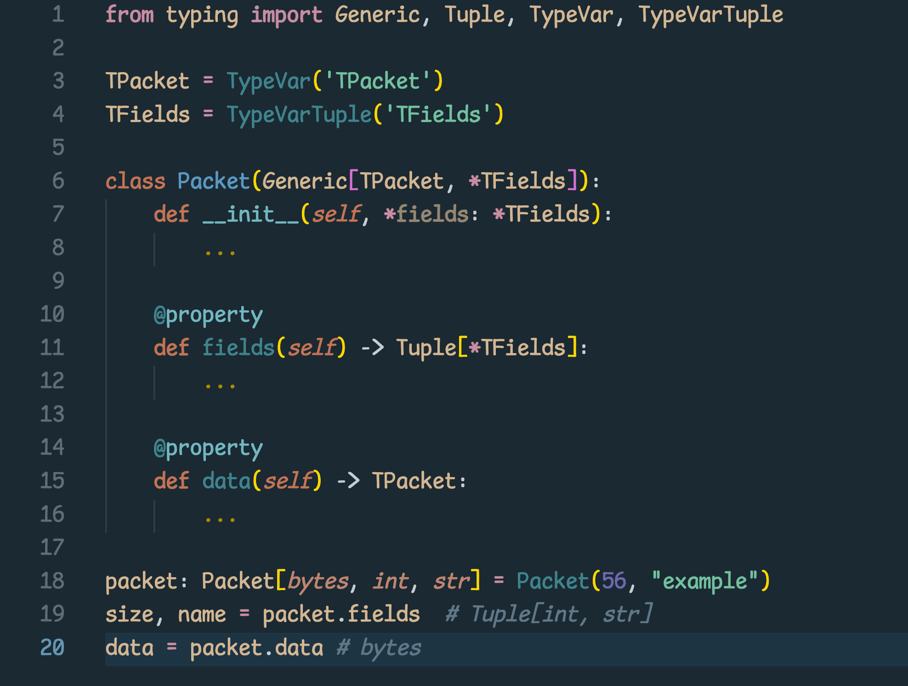
Variadic Generics 可変長ジェネリクス

Slide 18
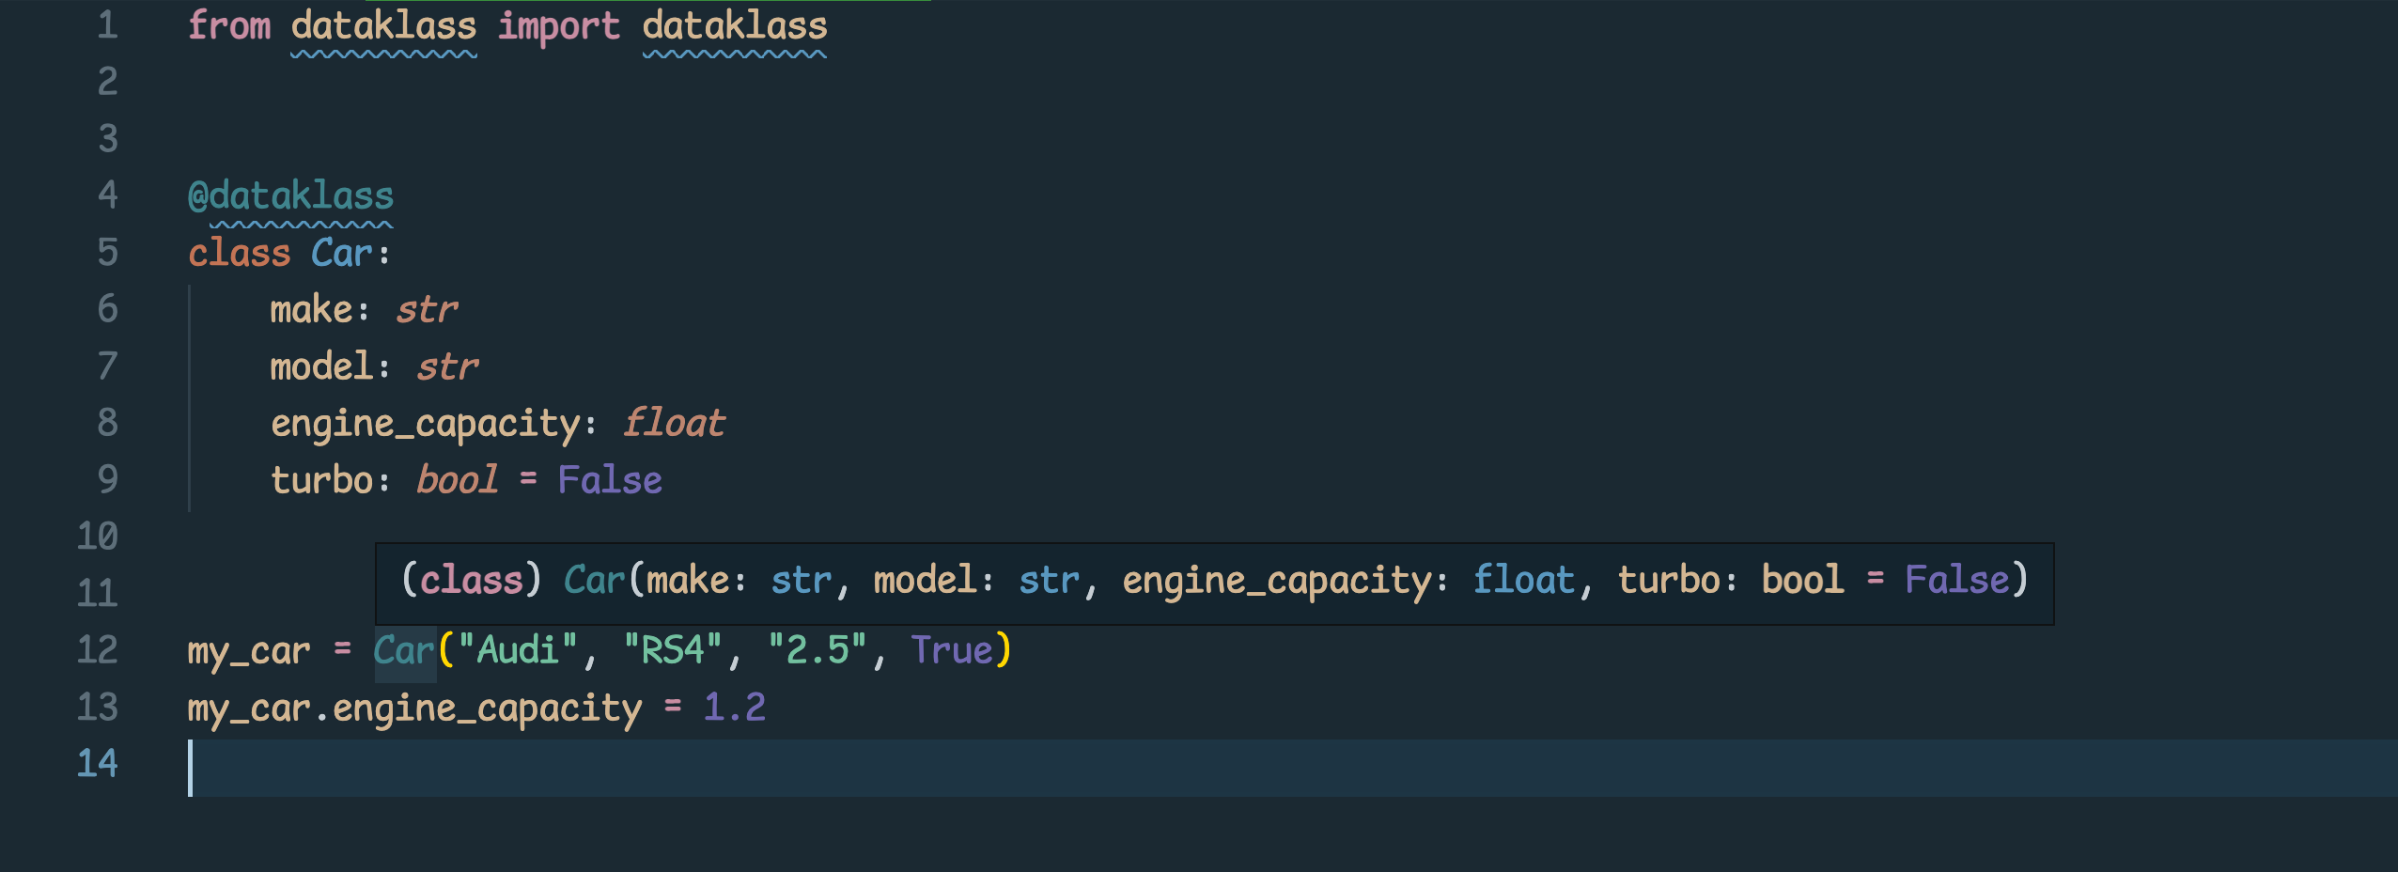
Data class transforms データクラス変換
Implement your own versions of dataclass and get native support for type checkers and IDEs.
Checkout Dave Beazleys’s minimal “dataklass” library for a good example of using this.
Already available as a backport and implemented in Pydantic.

Slide 19
New modules

Slide 20
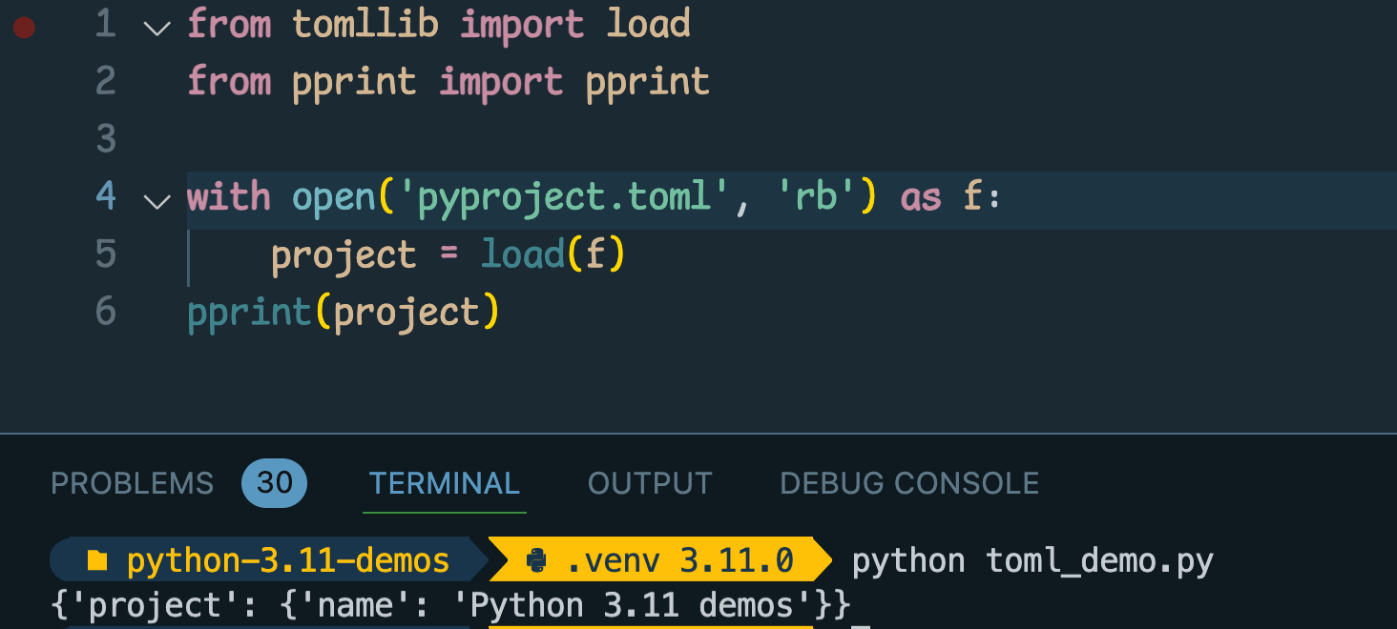
TOMLlib
Implements a very basic TOML library for reading TOML files.
Only has 2 methods
load (f)
loads(s)
NB: open files in binary mode!

Slide 21
Performance Improvements
パフォーマンスの改善

Slide 22
More
Scale-out Infrastructure
Rewrite in Cython
Implement in PyPy
Optimize Existing Code
Optimize DB/IO
Impact
Caching Tiers
Minor-Version Python Upgrades
Less
Less
Code Changes
More

Slide 23
Selecting a Profiler
Profiler選択マトリックス
 | Type | Level | Multi process | Asyncio | Python Support
austin | Sampler | line | ✔︎ | ✔︎ | 3.7-3.10
scalene | Sampler | line | ✔︎ | ✔︎ | 3.8-3.10
cProfile | Tracing | function |  |  | 2-3.11
pyinstrument | Sampling | function | ✔︎ | ✔︎ | 3.7-3.10
Py-spy | Sampling | function | ✔︎ | ✔︎ | 2-3.10
yappi | Tracing | function | ✔︎ | ✔︎ | 2-3.10

Slide 24
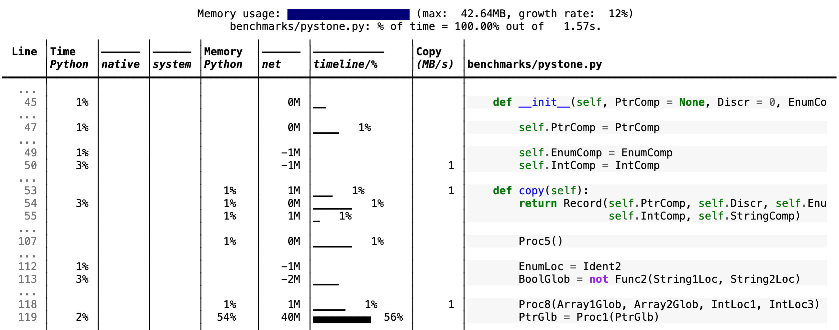
Scalene in action
Notes:
GPU reporting
Multiprocessing
Memory trends
System time, C time and Python time reporting

Slide 25
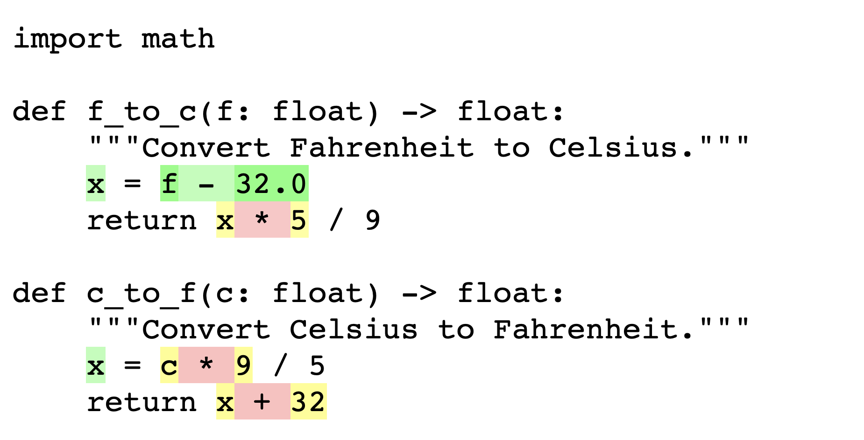
Specializing Adaptive Interpreter
Python is highly dynamic, making optimizations difficult
PEP659, the Specializing Adaptive Interpreter is part of the work to make Python 4x faster over the next few releases.
Python 3.11 will optimize this to a float subtraction instead of a generic subtraction

Slide 26
Assorted performance updates
Exception handling goes from 10-15% overhead to ~1% overhead
Regular expressions are ~10% faster
Function calls are 10-20% faster

Slide 27
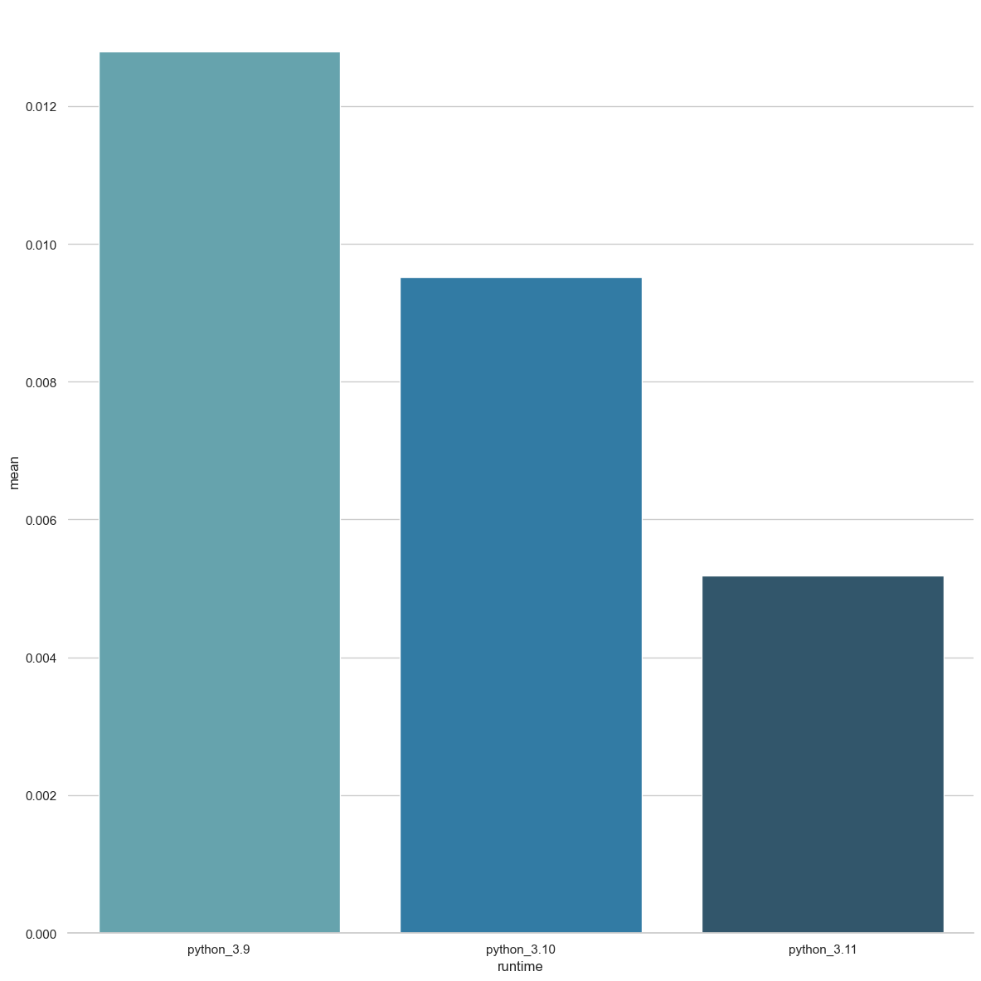
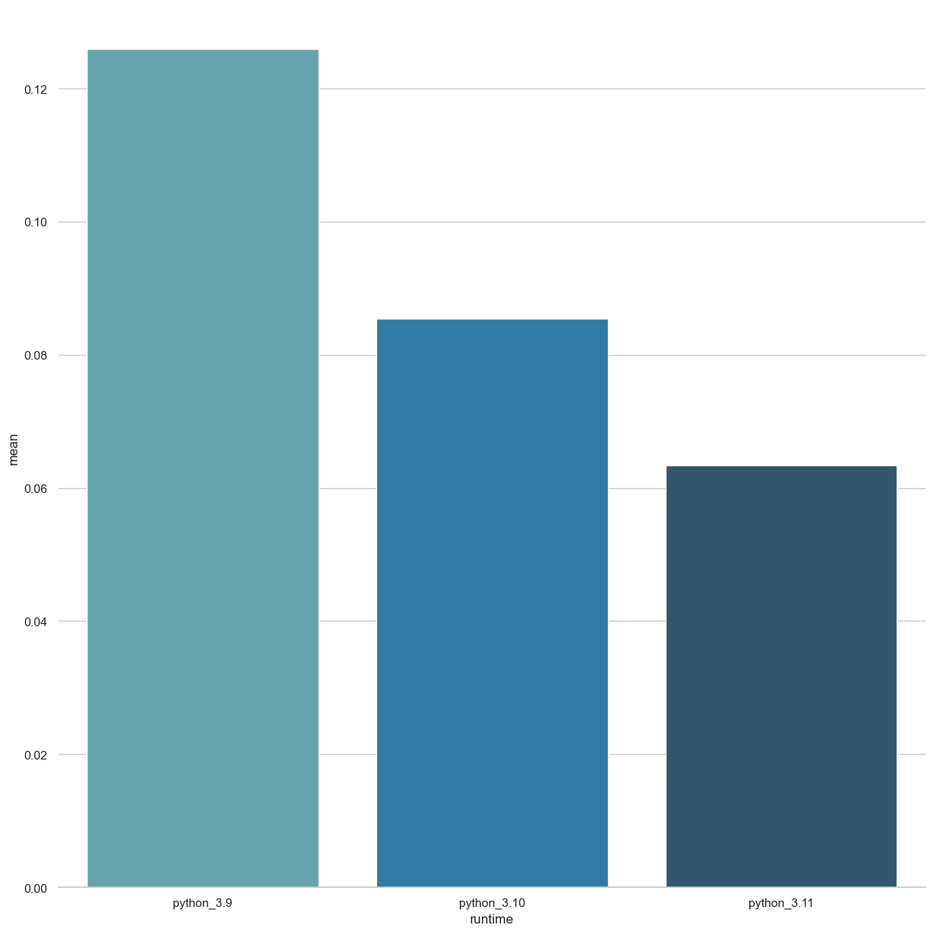
Realistic Benchmark results
Delta Blue benchmark uses:
- Classes, method calls and class methods
- Loops
Richards benchmark uses:
- Classes, method calls and class methods
- Loops
-20%
-30%
-20%
-60%
-50%
-60%
3.9
3.10
3.11
3.9
3.10
3.11

Slide 28
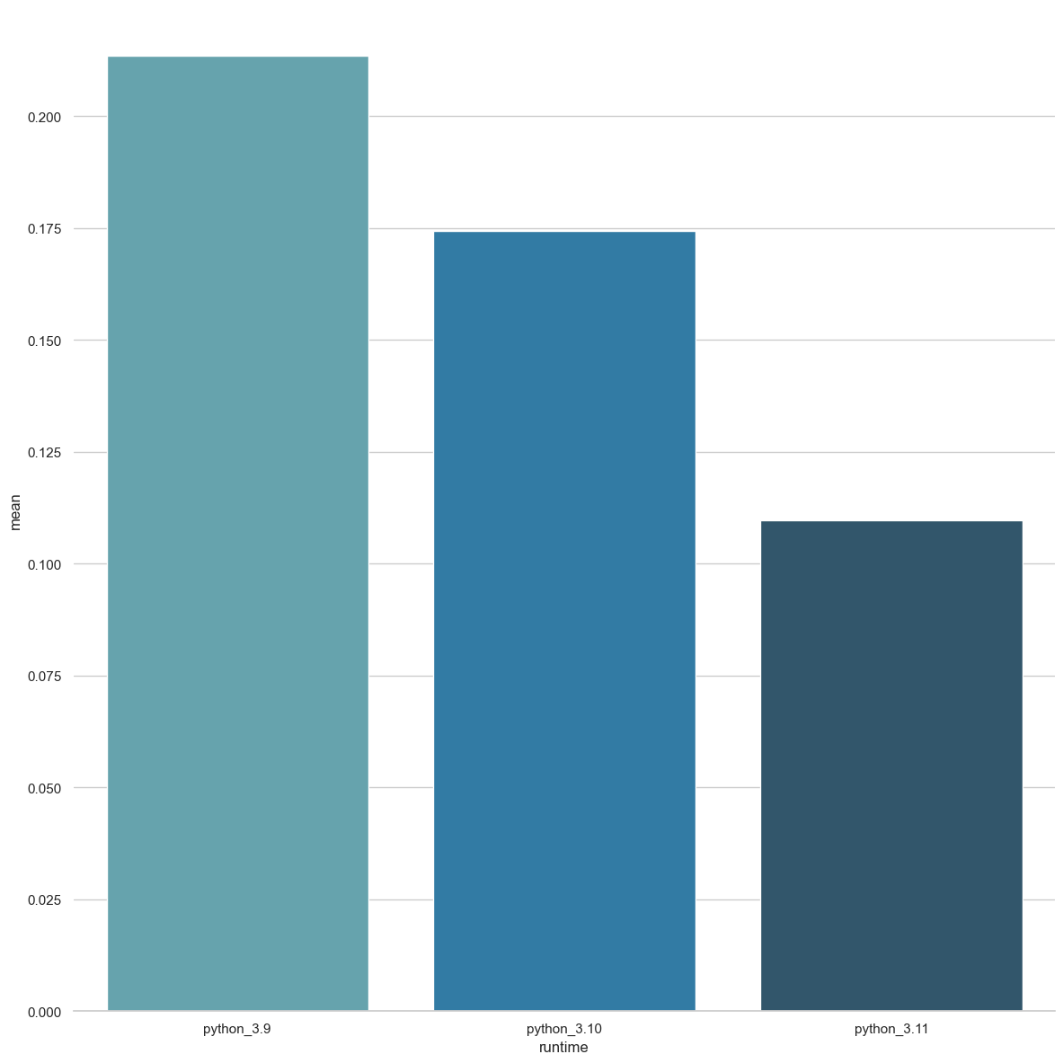
Math Benchmark results
Nbody benchmark uses:
- Tight, nested loops
- Floating point arithmetic
If your code is float-heavy, this is a good representation
-20% vs 3.9
-50% vs 3.10
-60% vs 3.9
3.9
3.10
3.11

Slide 29
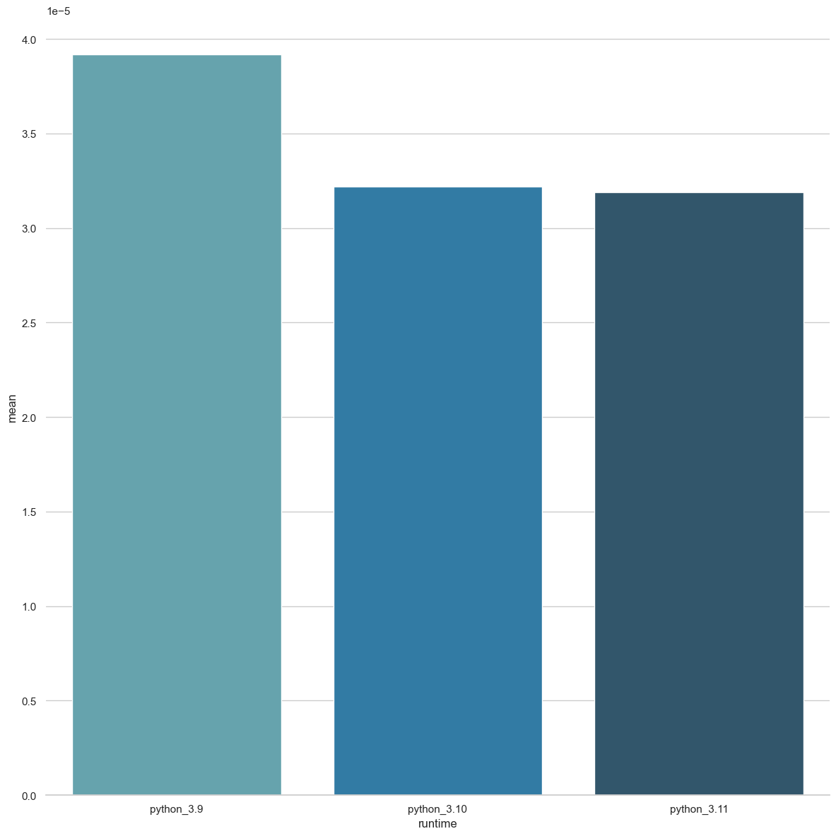
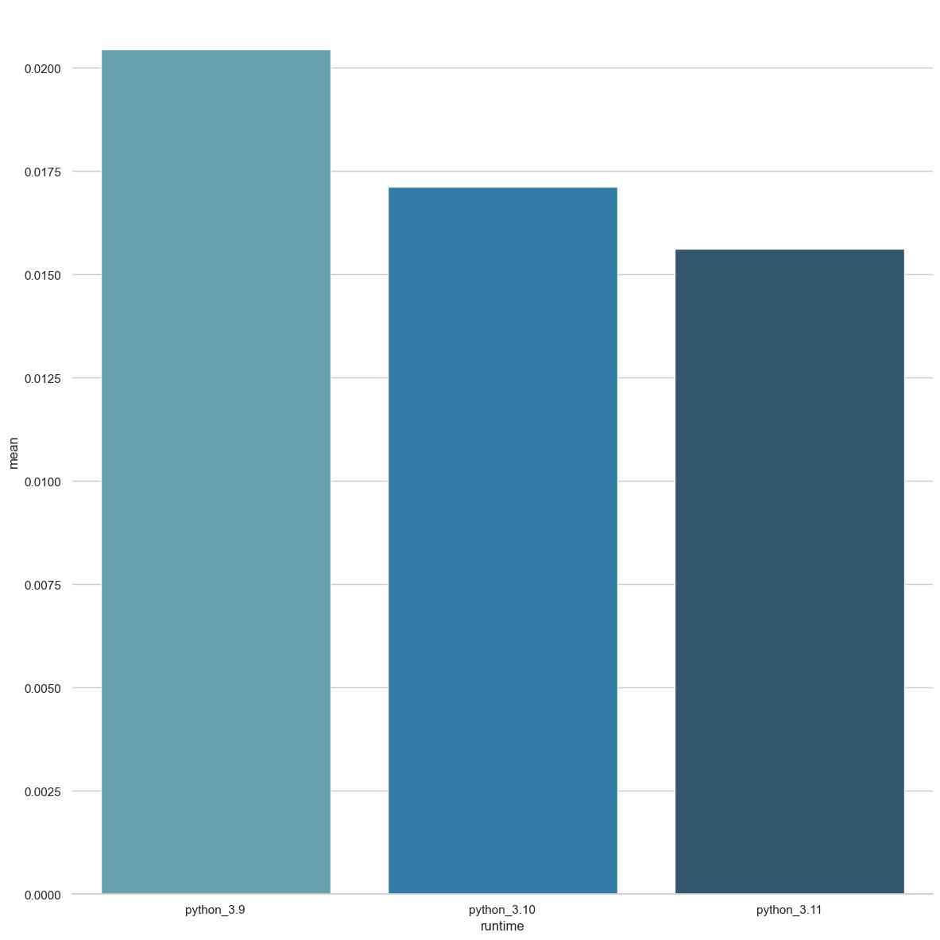
JSON serialization
Serialize
Deserialize
3.9
3.10
3.11
3.9
3.10
3.11

Slide 30
What does this mean for me?
Expect ~20-30% performance improvement in most applications
Benchmark your code
Transition from 3.9 – 3.11 could show a 2x performance gain

Slide 31
What can we expect in the future?
More performance improvements!
Python 3.12 is already being worked on
Lazy Imports
Per interpreter GIL (was called sub-interpreters)
Python 3.13, 3.14 and 3.15 are scheduled for the next 3 years
There is no mention of Python 4 (yet)

Slide 32
Summary
Start testing soon so you’re ready to upgrade
Benchmark your code so you can share the performance differences
Checkout gradual typing if you haven’t already

Slide 33
Questions
@anthonypjshaw
aka.ms/pyconjp-slides

